Slide 1

ABFRL Brands-Search Flow App Tagging
17th Oct 2023

Slide 2
Guidelines to Implement Tagging
Adobe Launch SDK should be installed before the custom tagging.
Copy and paste the keys of contextData as it is without changing the Camel Casing.
Context Data should be along with calling the Track State and Track Action functions.
<> this indicates dynamic value to be captured and passed.
Icid will be added to the next page’s URL where user lands after clicking any content of current page.
Testing will be performed by Implementation Team after ABFRL QA team will give the confirmation/sign off for the testing done by them.
UAT should be done first in staging and then in production post production UAT adobe’s codes are pushed to live.
For Customer ID, pass the value only when available else pass it as blank.

Slide 3
Super App Brands
Since Super App contains multiple cross-brands journey, therefore w.r.t to tracking the brand/product brand currently included( along with the value to be passed in the contextData key)
Brand/Product Brand | Context Data Value
Van Huesen | vh
Peter England | pe
Allen Solly | as
Louis Phillipe | lp
Reebok | rbk
American Eagle | aoe
Forever 21 | f21
Simon Carter | sc

Slide 4


On interaction with search field

Slide 5
click type | Tracking type | Launch variables | Expected values
Interaction | Field interact | let contextData={ linkName:“search initiate", channel: "<android/ios>|<current page name>",// page name without word “page” from where user clicked on my account icon brand: "<brand name>“ searchInitiate: 1 // will be passed an integer value only when user will interact with search field. linkPageName: “<page name>",//page from where user initiates search customerID : "<customerID>", // only pass when available loginStatus : "<logged-in/guest>" , platform: "<desktop website/mobile website>", userDetails: "<gender>|<age>", // pass only when user is logged in dob: "<date of birth>" // pass only when user is logged in }; ACPCore.trackAction("search initiate", contextData); | loginStatus may have the values:- logged-in guest Channel values can be:- android|home ios|category

Slide 6
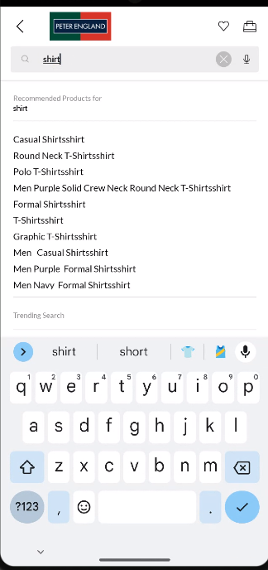
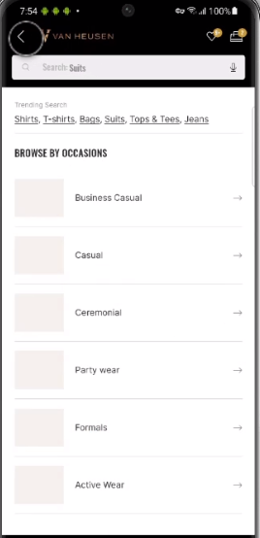

On click of search initiate

Slide 7
click type | Tracking type | Launch variables | Expected values
Icon click or enter button or autosuggested term click | CTA | let contextData={ linkName:“search click", channel: "<android/ios>|<current page name>",// page name without word “page” from where user clicked on my account icon brand: "<brand name>“, searchInitiated: 1 // will be passed an integer value only when user will perform a search successfully . linkPageName: “<page name>",//page from where user initiates search searchTerm : “ <term searched>”, customerID : "<customerID>", // only pass when available loginStatus : "<logged-in/guest>" , platform: "<desktop website/mobile website>", userDetails: "<gender>|<age>", // pass only when user is logged in dob: "<date of birth>" // pass only when user is logged in }; ACPCore.trackAction("search click", contextData); | loginStatus may have the values:- logged-in guest

Slide 8
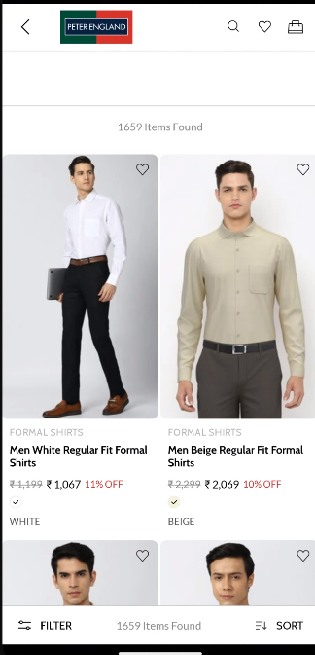
On load of search result page

Slide 9
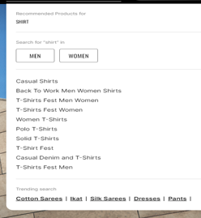
Page type | Tracking type | Launch variables | Expected values
Search page | On load | var let contextData={}; let contextData={ pageName: “search listing page", channel: "<android/ios>|search", brand: "<brand name>“, customerID : "<customerID>", // only pass when available loginStatus : "<logged-in/guest>" , pageType : “search”, searchTerm : “ <term searched >”, searchType : “ <type of search>”, searchResultCount : “<number of search results>”, platform: "<desktop website/mobile website>", userDetails: "<gender>|<age>", // pass only when user has logged in dob: "<date of birth>" // pass only when user is logged in // pass only when user has logged in }; ACPCore.trackState("search listing page", contextData); | loginStatus may have the values:- logged-in Guest <type of search> will have Normal search ( when user search his/her term manually) Predictive Search ( When user select an autosuggested or entered term predictive keyword) 3. Null search ( when there will be no matching search result as per the term searched).

Slide 10
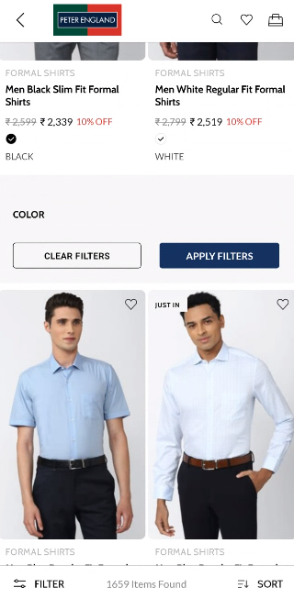
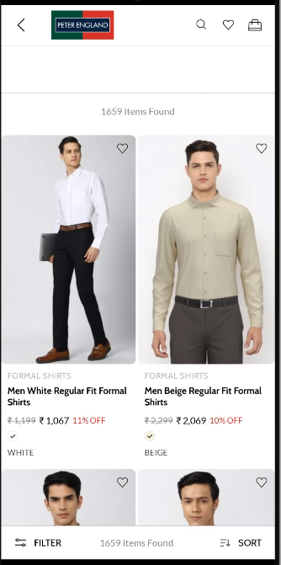
On all CTA clicks

Slide 11
click type | Tracking type | Launch variables | Expected values
Multiple clicks | button | let contextData={ linkName:“<cta clicks>", channel: "<android/ios>|search", brand: "<brand name>“, linkPageName: “search listing page", customerID : "<customerID>", // only pass when available loginStatus : "<logged-in/guest>" , filterName: “< filter 1 applied|filter 2 applied|…filter N applied>”. // only when filter is applied filterValue: “<filter 1 value| filter 2 value|….filter N value>” // only when filter is applied sortBy : “<sort by option>”, // only when user has manually sorted. platform: "<desktop website/mobile website>", userDetails: "<gender>|<age>", // pass only when user is logged in dob: "<date of birth>" // pass only when user is logged in }; ACPCore.trackAction("<cta clicks>", contextData); Note: when user comes to search results entire tagging will be the same mentioned in PLP CTA click tagging except, the linkPageName will change to search listing page | loginStatus may have the values:- logged-in guest In filterName, the expected values are gender category sizes color discount subbrand occation price fit sleeves Eg. “gender, category, sizes, color” In filterValue, the expected values are men formal shirt 42 green women vh sport v dot Eg. “men, formal shirt, 42, green” In sortBy, expected values are popular new arrivals discount

Slide 12

On adding product to Wishlist

Slide 13
click type | Tracking type | Launch variables | Expected values
Add to wishlist | icon | let contextData={ linkName:“<add to wishlist/remove from wishlist>", channel:"<android/ios>|search ", linkPageName: “search listing page", customerID : "<customerID>", // only pass when available loginStatus : "<logged-in/guest>" , brand: “<brand name>”, wishlistAdded : 1, // 1 as numeric value and key should only be passed when product will be move to wishlist. wishlistRemoved : 1, // 1 as numeric value and key should only be passed when product will be removed from wishlist. platform: "<desktop website/mobile website>", productID: "<product ID>", productCategory: "<product category>", productName: "<product name>", userDetails: "<gender>|<age>", // pass only when user is logged in dob: "<date of birth>" // pass only when user is logged in }; ACPCore.trackAction(“<add to wishlist/remove from wishlist>", contextData); | loginStatus may have the values:- logged-in guest productID: will have the value of SKU ID of the product. productCategory: will have the category of the product. Example:- shirt Trouser productName: name of the product. In brand, the expected values are vh as lp pe reebok aoe f21 sc

Slide 14
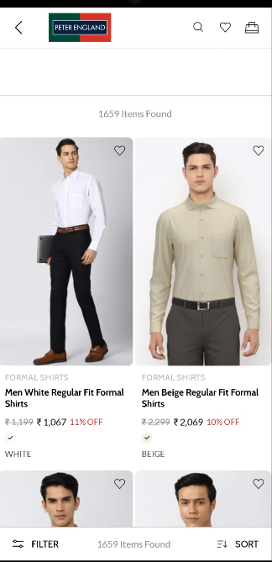

On click of product

Slide 15
Click type | Tracking type | Launch variables | Expected values
Product click | widget | let contextData={ linkName:“product click", channel: "<android/ios>|search", brand: "<brand name>“, linkPageName: “search listing page", customerID : "<customerID>", // only pass when available loginStatus : "<logged-in/guest>" , brand: “<brand name>”, productID: "<product ID>", productCategory: "<product category>", productName: "<product name>", productPosition: “<position of the product clicked>”, stockStatus: "<product stock status>", size: "<product size>", brandName: “<brand name>”, pfm : “<section of the page/ product finding source>”, platform: "<desktop website/mobile website>", userDetails: "<gender>|<age>", // pass only when user is logged in dob: "<date of birth>" // pass only when user is logged in }; ACPCore.trackAction("product click", contextData); | loginStatus may have the values:- logged-in guest pfm means product finding method, the expected values will be the section of the page from where the user has found the product. Eg : “home product slider” “internal search” “internal campaign” “similar products” “top picks” “breadcrumb” “navigation/browsing” “promos” “wishlist/favorites” “collections” “cross-Sell” “campaign landing pages” stockStatus: provide whether product is in stock or out of stock eg – stockStatus : “out of stock” or “available” size: example values:- 42 L In brand, the expected values are vh as lp pe reebok aoe f21 sc

